Slide 1
Predicting Flight Delays In Advance
iPEC Solutions Private Limited
Under The Guidence of:
Fathima Afroz Mam
Presented By:
Muhammed Shaheel

Slide 2

Introduction
Problem statement :
Flight delays pose significant operational challenges for airlines and inconvenience passengers, leading to increased costs, reduced customer satisfaction, and logistical inefficiencies. Various factors, including weather conditions, air traffic congestion, airline schedules, and operational inefficiencies, contribute to flight delays.
Objectives :
Predict Flight Delays.
Identify Key Factors Influencing Delays.
Optimize Airline Operations.
Forecast Passenger Demand.
Improve Customer Experience.
Develop a Real-Time Prediction System.

Slide 3
Introduction
Significance of the Project:
1. Operational Efficiency for Airlines
Helps airlines optimize flight schedules to minimize delays and disruptions.
Reduces operational costs related to fuel wastage, crew overtime, and airport congestion.
Supports better resource management, including aircraft turnaround times and staffing allocation.
2. Improved Passenger Experience
Enables proactive communication with passengers regarding potential delays, reducing frustration.
Allows passengers to make informed travel decisions, such as rescheduling flights or adjusting plans.
Enhances customer satisfaction and loyalty through improved service reliability.
3. Data-Driven Decision Making
Identifies key factors contributing to delays, such as weather conditions, air traffic congestion, and airline operations.
Provides actionable insights for policy improvements in airport and airline management.
Assists in predicting demand trends, helping airlines adjust pricing, staffing, and fleet management.
4. Contribution to Aviation Research & Technology
Demonstrates the practical application of AI and machine learning in the aviation industry.
Encourages further research into real-time prediction models and dynamic scheduling.
Lays the foundation for integrating advanced predictive analytics into airline operations.

Slide 4
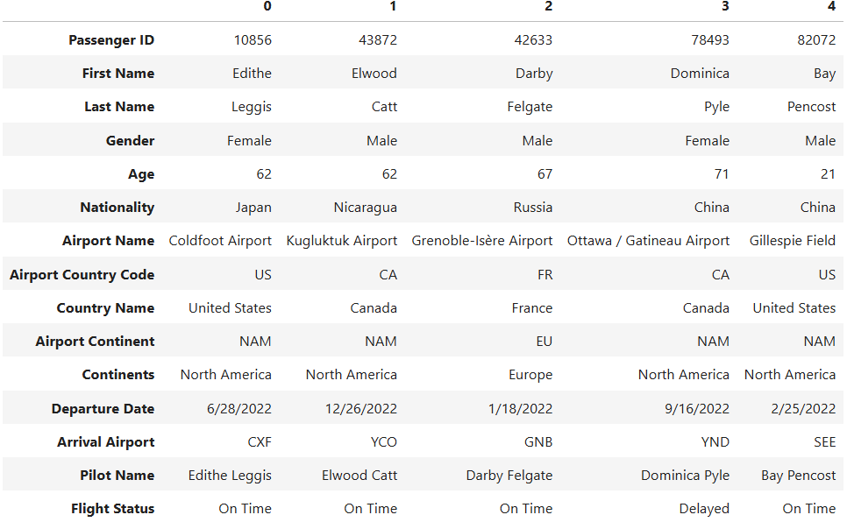
DATASET OVERVIEW
Data Source :
Dataset Name: Airline Dataset.csv
Source: Collected from kaggle
Type: CSV (Tabular Data)
Size: 11.96 MB
Number of Rows: 98,619
Number of Columns: 15

Slide 5
Numbers dataset contains:
Number of Samples (Rows): 98,619
Number of Features (Columns): 15
3. Initial Observations
🔹 Missing Data:
Some values (e.g., Technical Issues, Weather Conditions) may have missing entries requiring imputation.
🔹 Outliers:
Extreme values in Delay_Duration (e.g., 500 minutes) might indicate data entry errors or unusual events.
🔹 Feature Importance:
Variables like Weather_Conditions and Air_Traffic_Congestion are likely to have strong correlations with flight delays.
Job-related features may not directly affect flight delays but can help understand the workforce trends in aviation analytics.

Slide 6
Exploratory data analysis (EDA)- summary statistics
Column Name | Count | Mean | Std Dev | Min | 25% | 50% (Median) | 75% | Max
Passenger ID | 98,619 | 55,168.69 | 25,985.44 | 10,000 | 32,608 | 55,338 | 77,695 | 99,999
Age | 98,619 | 45.50 | 25.93 | 1 | 23 | 46 | 68 | 90
3. Key Insights from EDA
🔹 Passenger Age Distribution:
The average passenger age is 45.5 years, with a wide range from 1 year to 90 years.
The median age is 46, indicating a relatively balanced distribution.
🔹 Flight Status Observations:
The dataset includes on-time and delayed flights, useful for predictive modeling.
Further analysis is needed to determine which factors contribute to delays.
🔹 Potential Features for Analysis:
Categorical: Gender, Nationality, Flight Status, Airport Name, Country Name.
Numerical: Age, Passenger ID (not useful for prediction).
Datetime: Departure Date (could be converted to extract features like season or time of day).

Slide 7
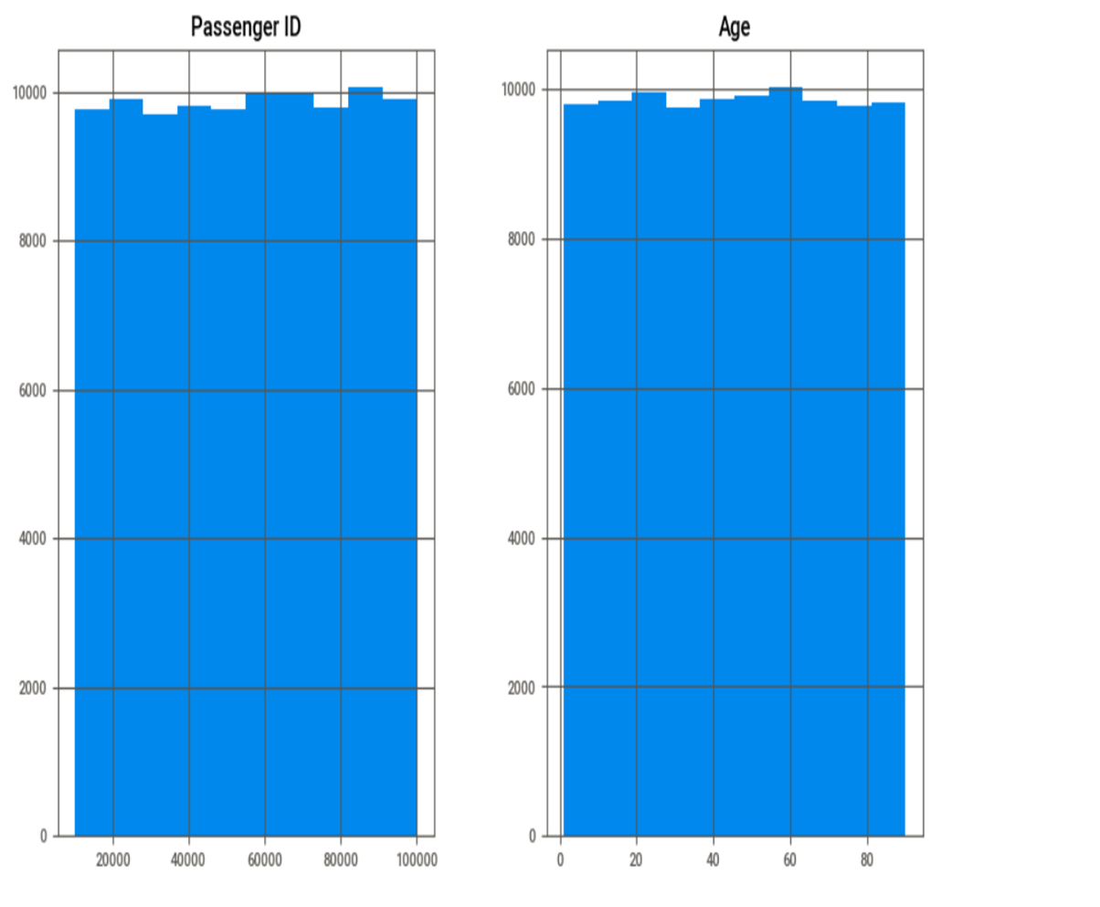
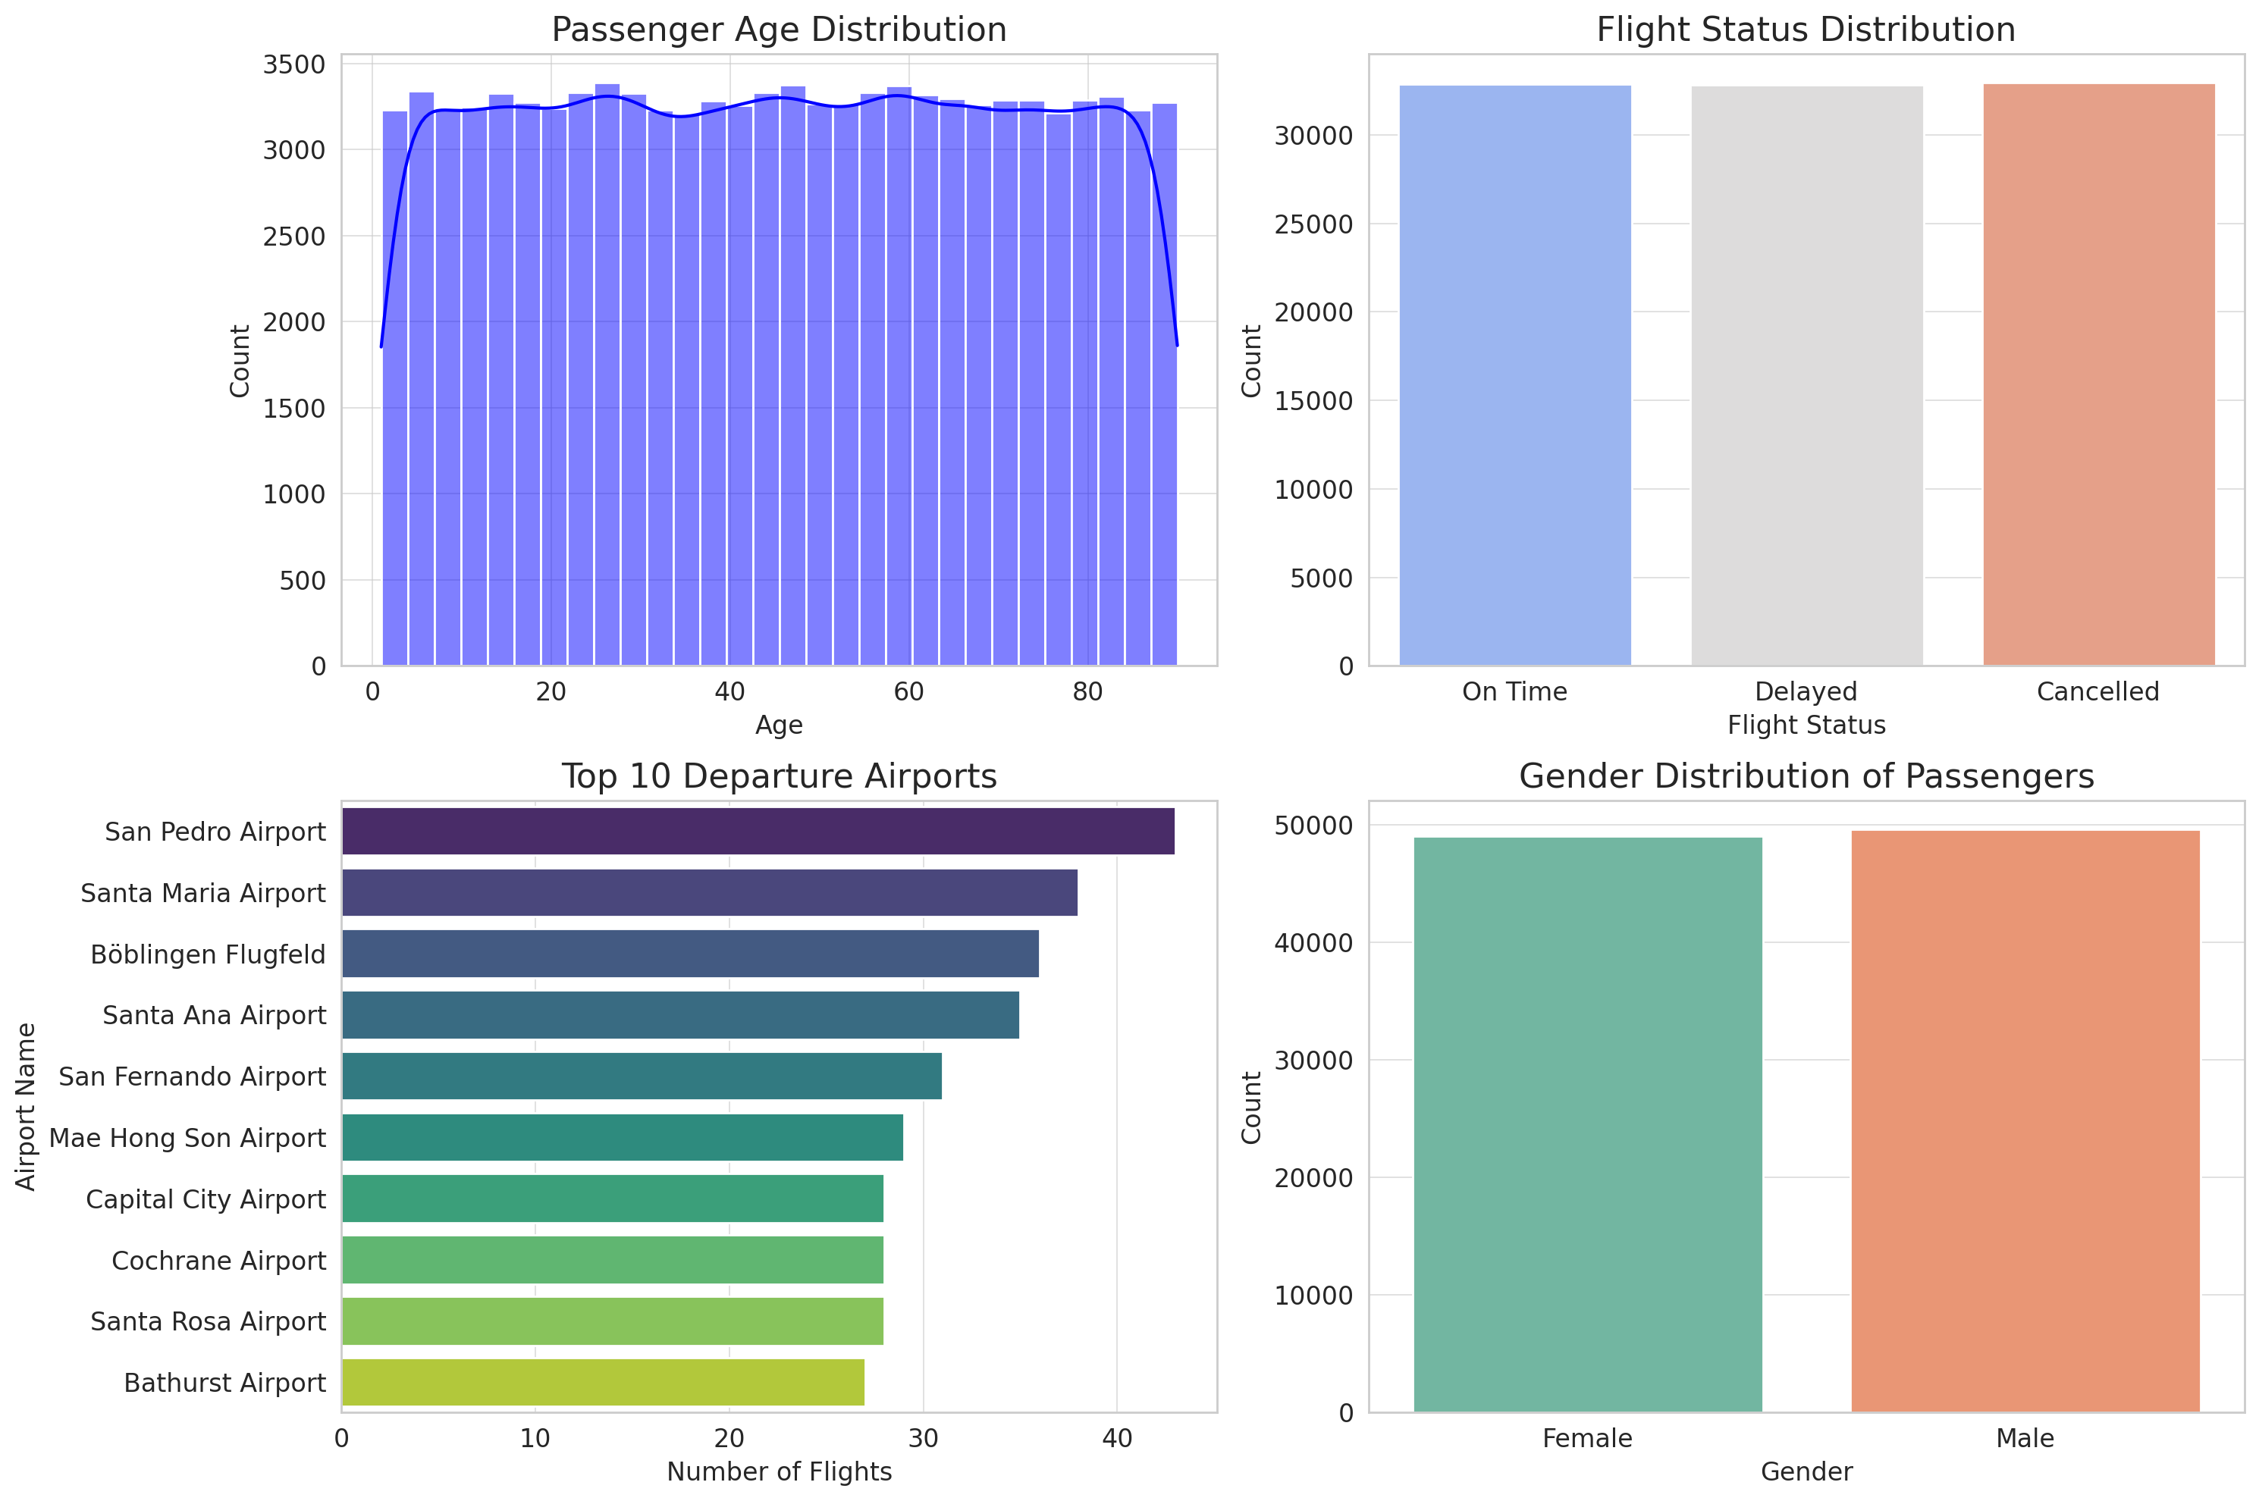
Exploratory Data Analysis (EDA)- Visualizations
The two histograms compare the distribution of Passenger IDs and Ages.
Passenger ID Histogram: Shows a relatively uniform distribution, indicating that the number of passengers is consistent across different ID ranges.
Age Histogram: Displays a consistent distribution across ages, with a slight increase in younger age groups.
Both histograms have a similar shape, suggesting consistency in the dataset with no clear outliers. The graph helps visualize the even distribution of these two variables within the passenger dataset.

Slide 8
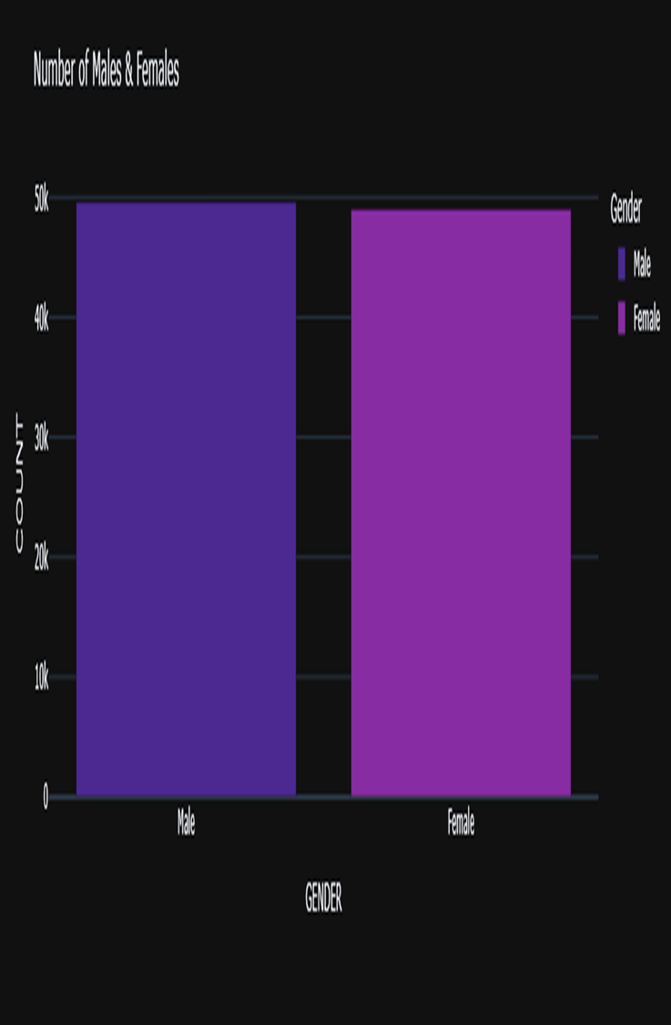


This bar chart represents the number of males and females in a dataset. Here’s what it indicates:Balanced Gender Distribution: The counts for males and females are nearly equal, suggesting a well-balanced representation of both genders in the dataset.Counts Around 50k: Each gender has a count close to 50,000, indicating a large sample size.Color Coding: The chart uses different shades of purple for males and females, making the distinction clear.Readability: The dark theme enhances visibility, with labels clearly indicating the gender categories and count values.

Slide 9
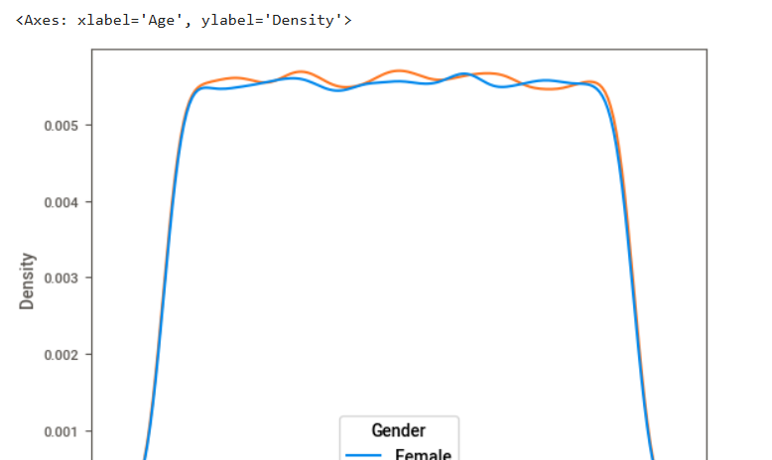

This density plot shows the age distribution for males (orange) and females (blue). The horizontal axis represents age, while the vertical axis indicates density (likelihood of finding someone at a given age). Key insights: Similar Age Distribution: Both genders follow a nearly identical pattern. Even Spread: Ages are fairly evenly distributed between 20 and 80. Higher Density in Youth: Slightly more people are under 20. Sharp Drops at Extremes: Fewer individuals at very young and old ages.

Slide 10
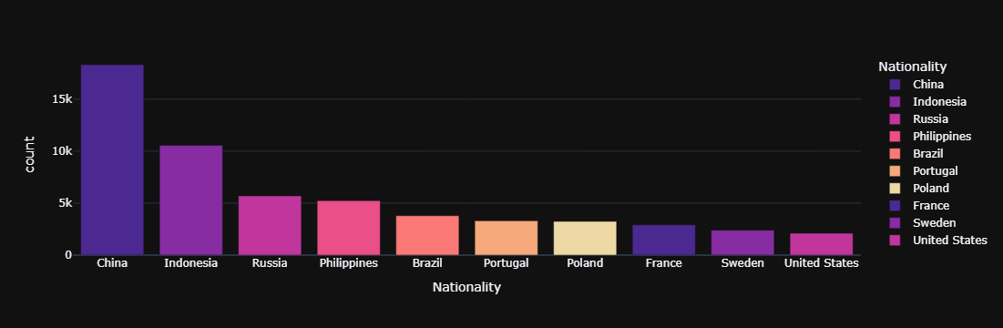
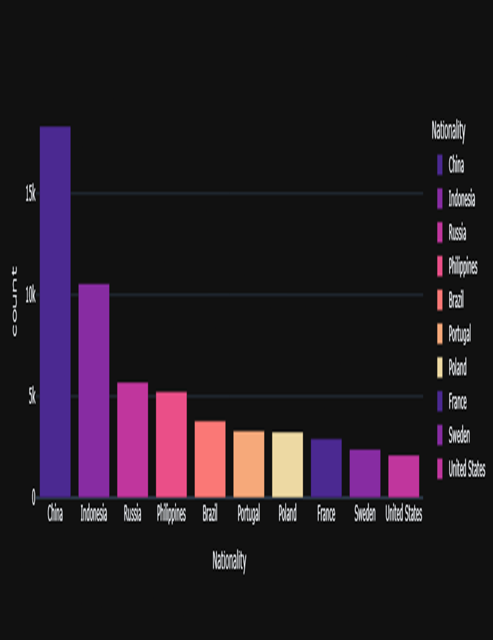
The bar graph illustrates the count of people from different nationalities, with China having the highest count, followed by Indonesia, Russia, Philippines, Brazil, Portugal, Poland, France, Sweden, and the United States. Each nationality is represented by a different color.

Slide 11
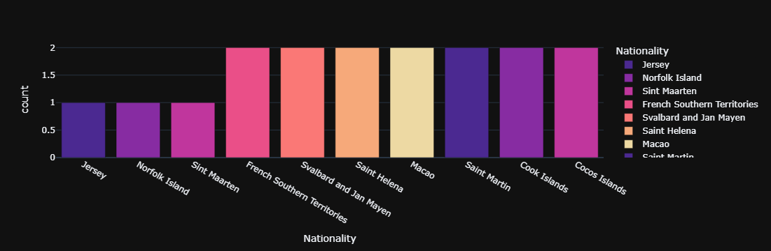

The bar graph shows the count of people from various nationalities. French Southern Territories, Svalbard and Jan Mayen, and Saint Helena have the highest counts at 2 each, while Jersey, Norfolk Island, Sint Maarten, Saint Martin, Cook Islands, and Cocos Islands all have a count of 1. This visual representation highlights the distribution of individuals from these specific nationalities.

Slide 12
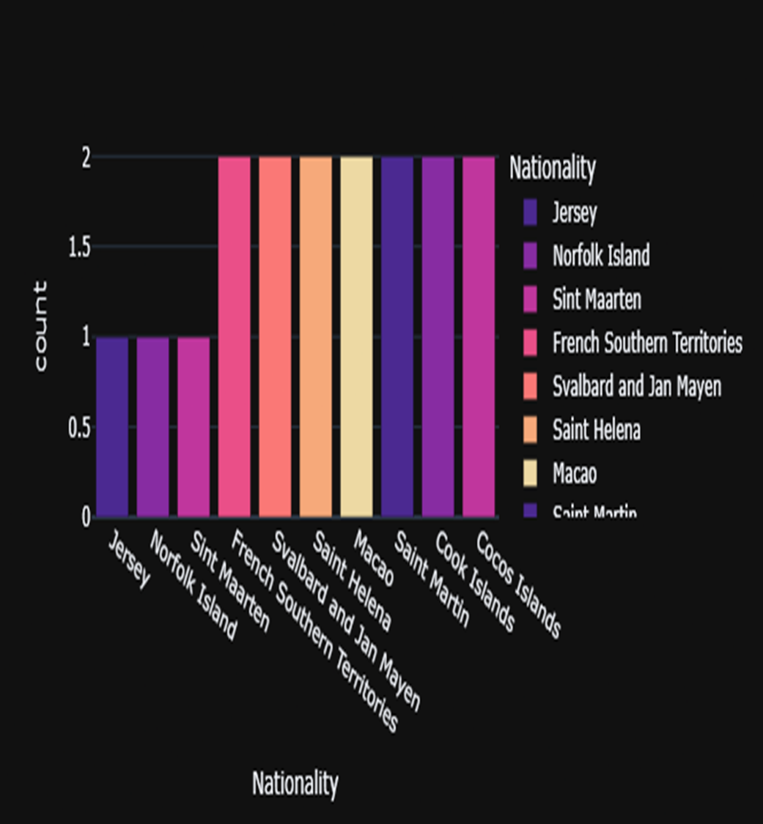

The bar graph presents the count of various nationalities, with French Southern Territories, Svalbard and Jan Mayen, and Saint Helena having the highest counts at 2 each. Jersey, Norfolk Island, Sint Maarten, Saint Martin, Cook Islands, and Cocos Islands each have a count of 1. This graph highlights the distribution of individuals from these specific nationalities.

Slide 13
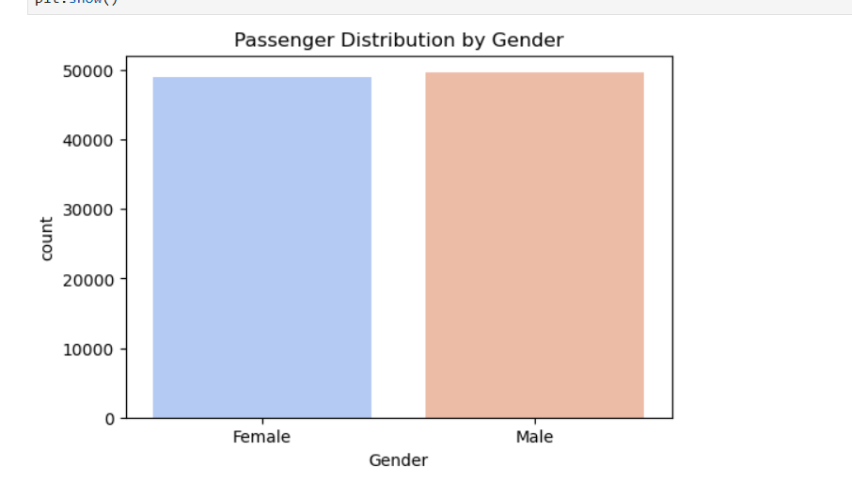

The bar chart displays the distribution of passengers by gender, showing an almost equal number of female and male passengers, indicating a balanced gender distribution.

Slide 14
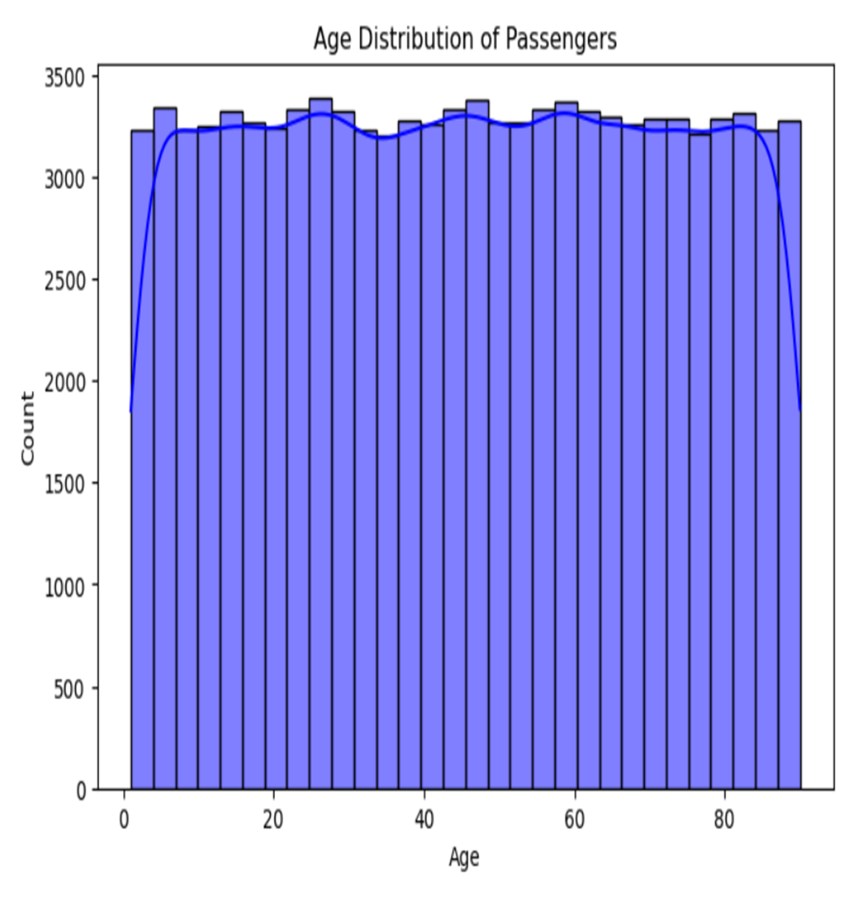

The histogram shows the age distribution of passengers, with ages ranging from 0 to 80+. It reveals a relatively even distribution between ages 20 and 80, with slight decreases in the very young (below 20) and very old (80+) age groups. This indicates a balanced age distribution with most passengers being adults.

Slide 15
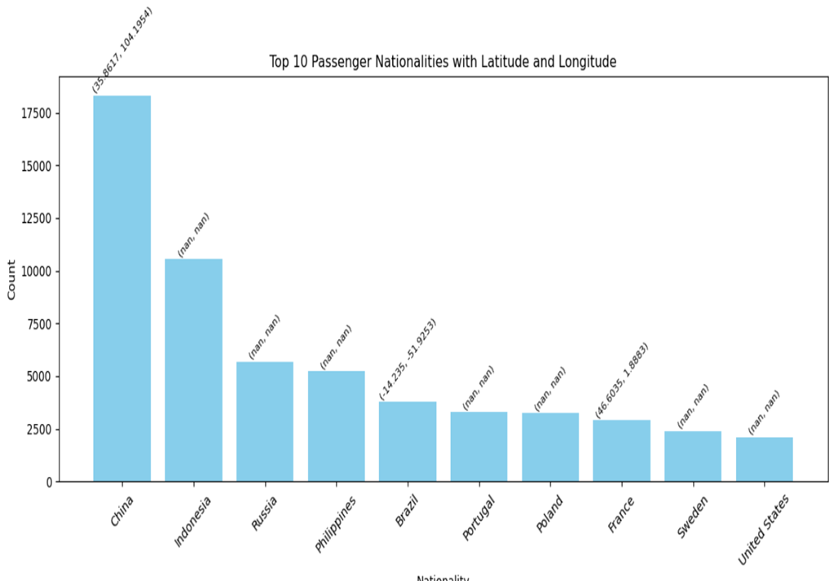
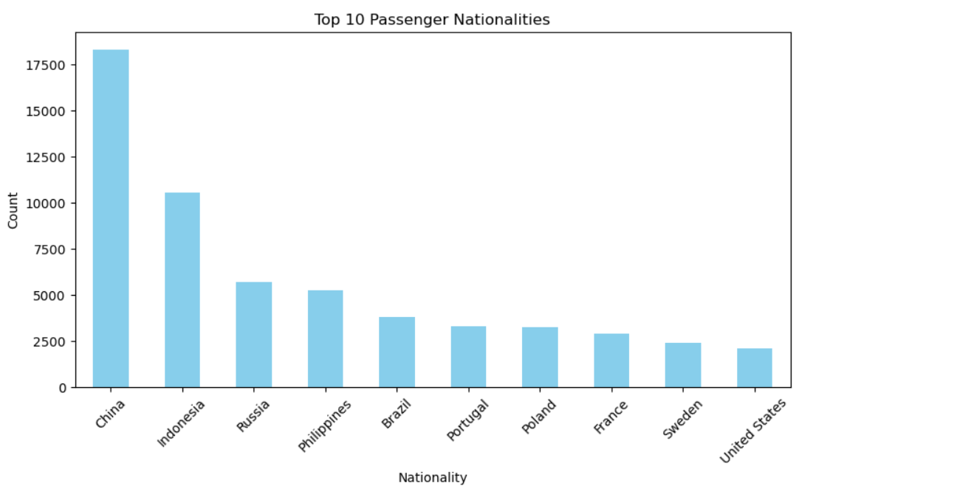

The bar graph shows the top 10 passenger nationalities, ranked by the number of passengers. China has the highest count, followed by other countries in descending order. This graph highlights the most represented nationalities among the passengers, with China being the clear leader.

Slide 16
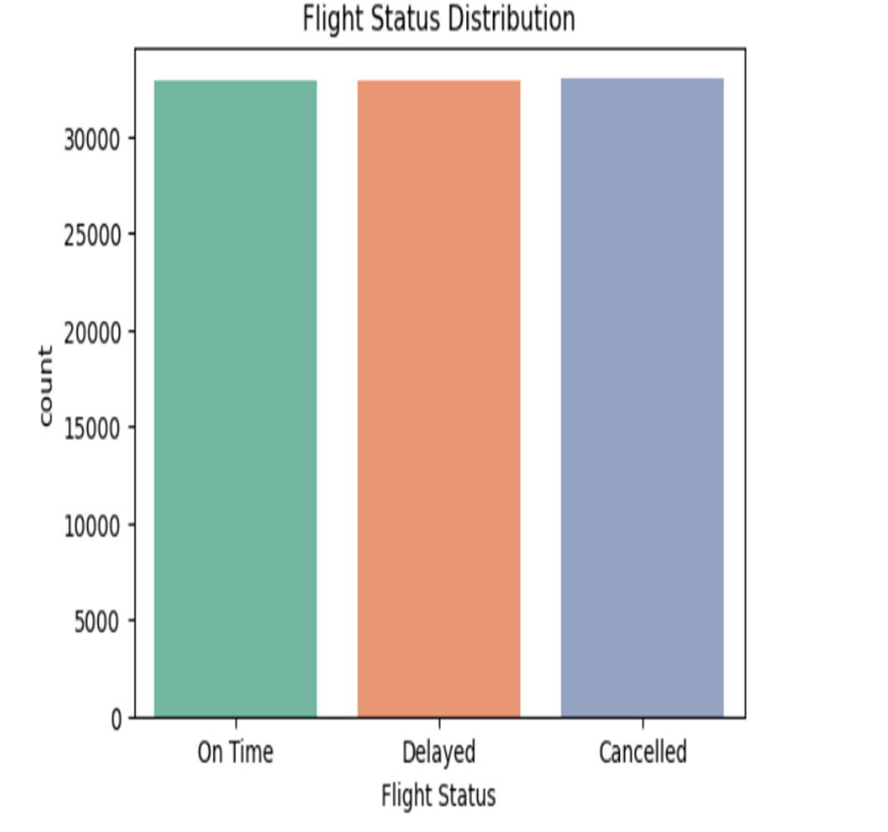

The bar graph displays the top 10 passenger nationalities by count, with China having the highest number of passengers. The graph includes latitude and longitude coordinates for some countries, providing geographic context. Missing coordinates indicate unavailable data. This graph highlights China's lead and offers a visual representation of the most represented nationalities among passengers.

Slide 17
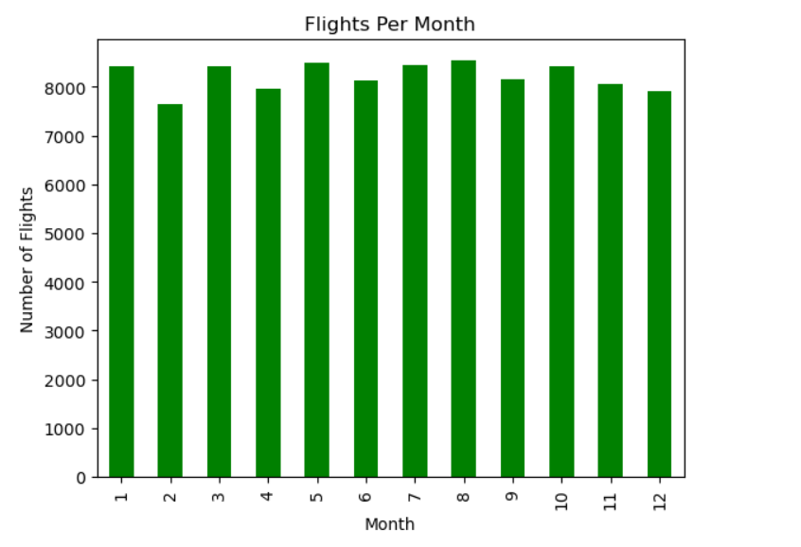
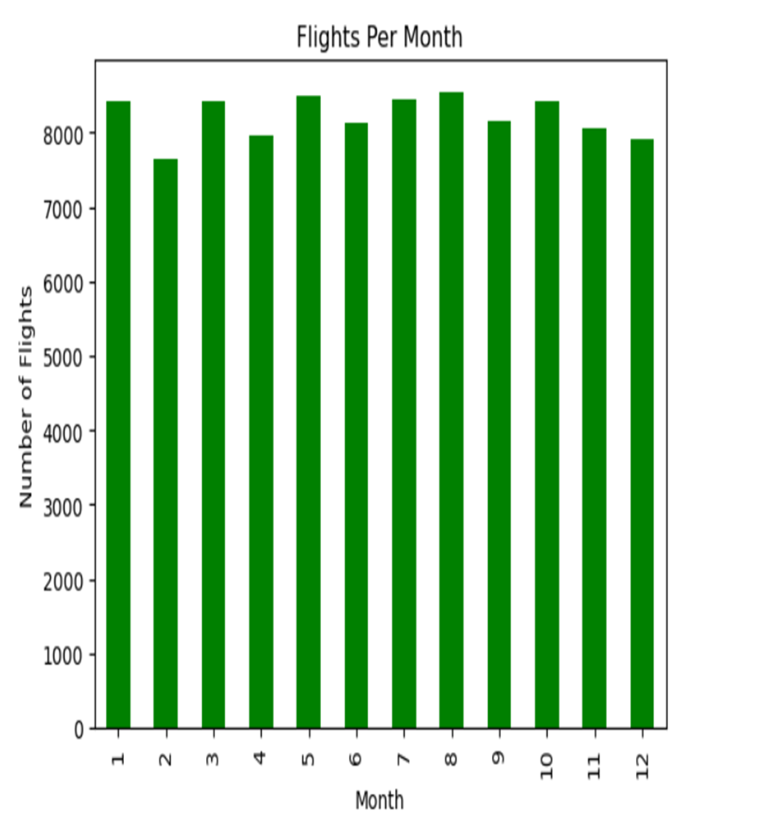
The bar graph illustrates the number of flights per month, with months 1, 3, 5, 6, 7, 8, and 10 showing higher flight numbers, and months 2, 4, 9, 11, and 12 having lower numbers. This indicates fluctuations in flight frequency throughout the year.

Slide 18
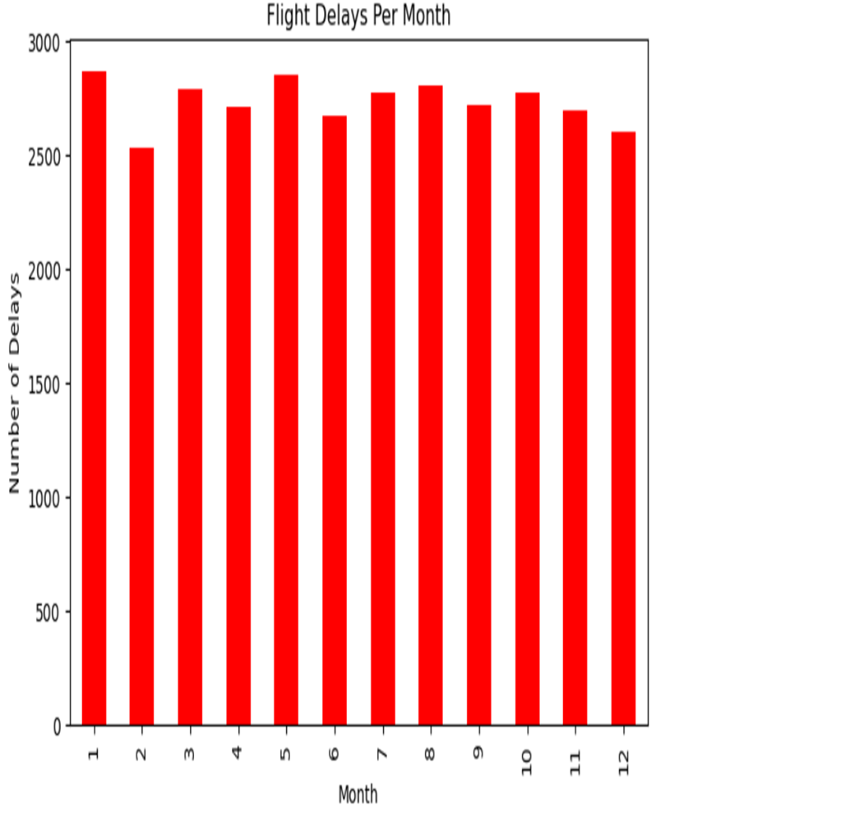

The bar graph shows the number of flight delays per month, indicating relatively consistent delays throughout the year. Months 1 and 5 have slightly more delays, while months 2 and 12 have slightly fewer. Overall, the pattern is stable with minor fluctuations.

Slide 19
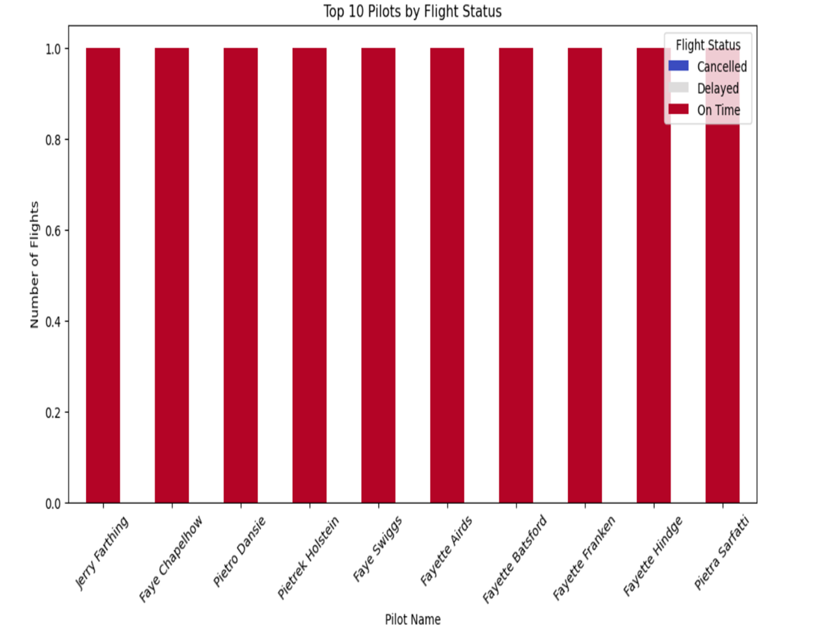
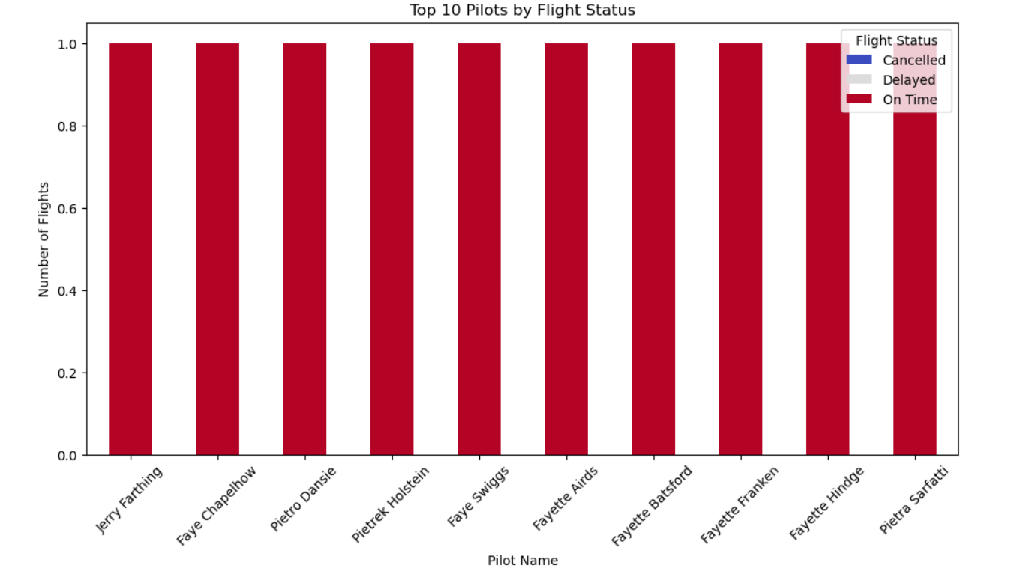
The 100% stacked bar chart shows the flight status (Cancelled, Delayed, On Time) for the top 10 pilots by the number of flights. All bars are entirely red, indicating that 100% of the flights for each of these pilots were on time, with no cancelled or delayed flights reported. This graph highlights the impeccable on-time performance of these top pilots.

Slide 20
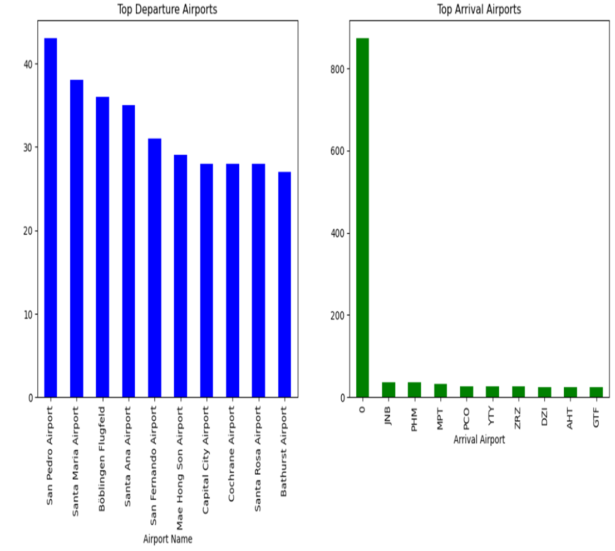

The graph features two separate bar charts. Left Chart (Top Departure Airports): Displays the top 10 airports by departures, with San Pedro Airport having the highest number. Right Chart (Top Arrival Airports): Shows the top 10 airports by arrivals, with Johannesburg (JNB) leading significantly. The charts highlight the disparity in traffic volume between departures and arrivals, suggesting an imbalance in the dataset.

Slide 21
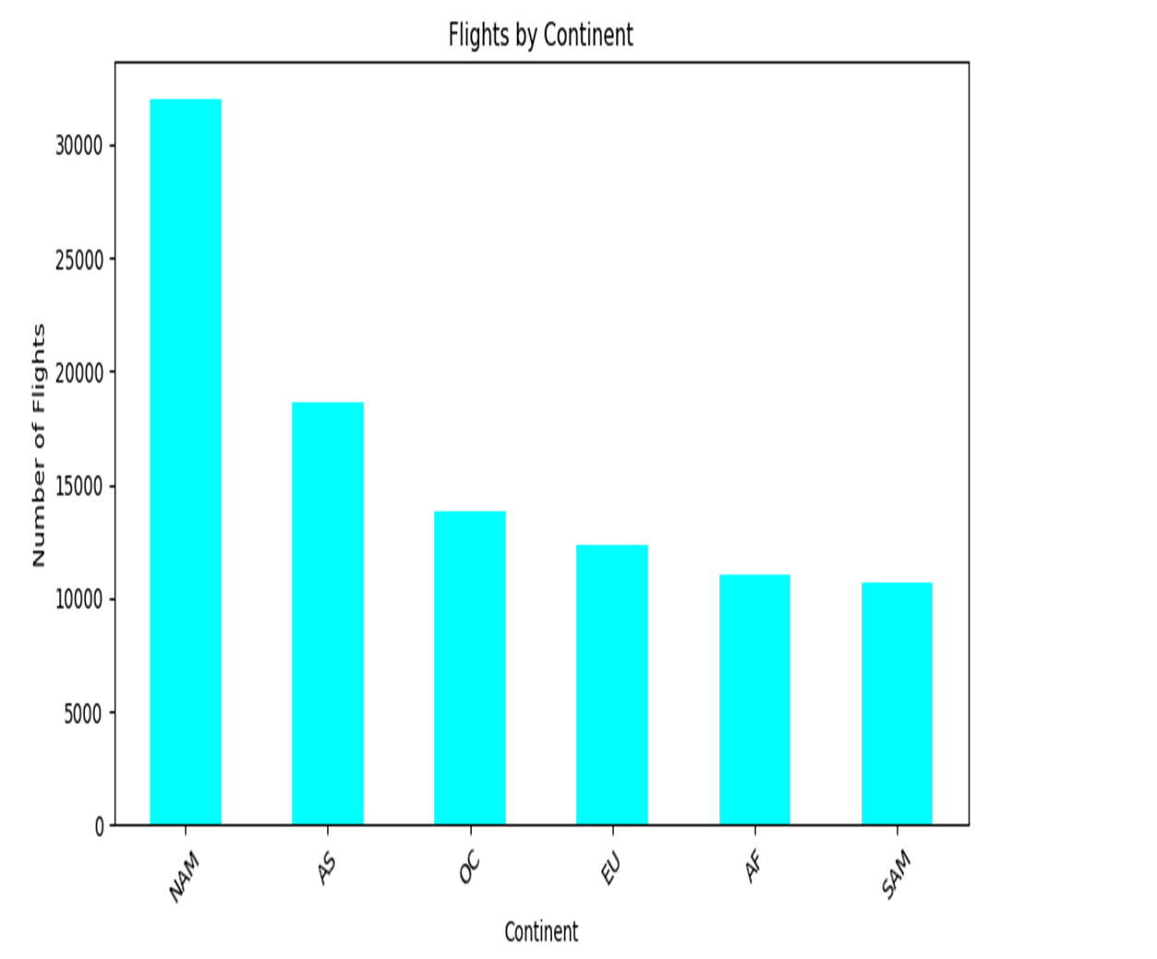
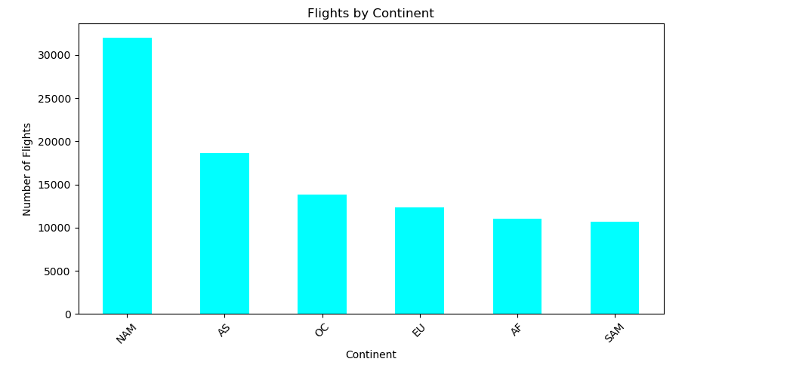
The bar graph displays the number of flights per continent, with North America having the highest volume, followed by Asia. Oceania, Europe, Africa, and South America have significantly fewer flights in comparison. This graph highlights the distribution of air traffic across different continents.

Slide 22
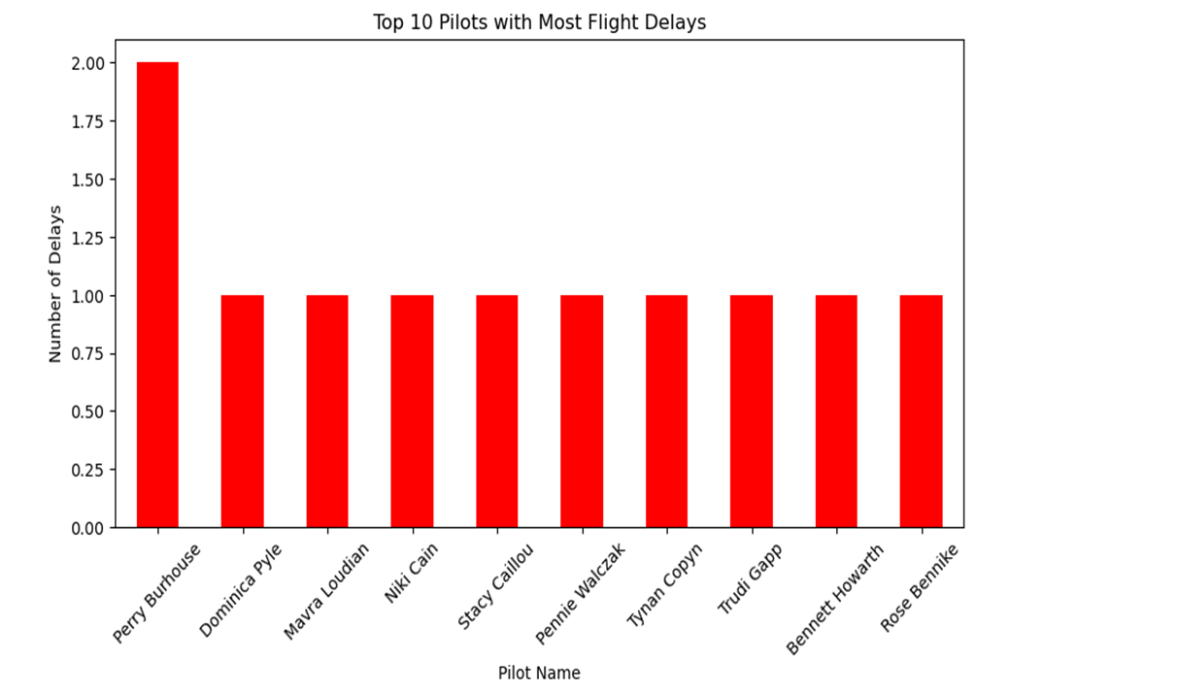

The bar graph displays the top 10 pilots with the most flight delays. Perry Burhouse leads with two delays, while the other nine pilots each have one delay. This graph highlights the delays attributed to these pilots, but doesn't provide information on pilots with fewer delays or the total number of pilots.

Slide 23
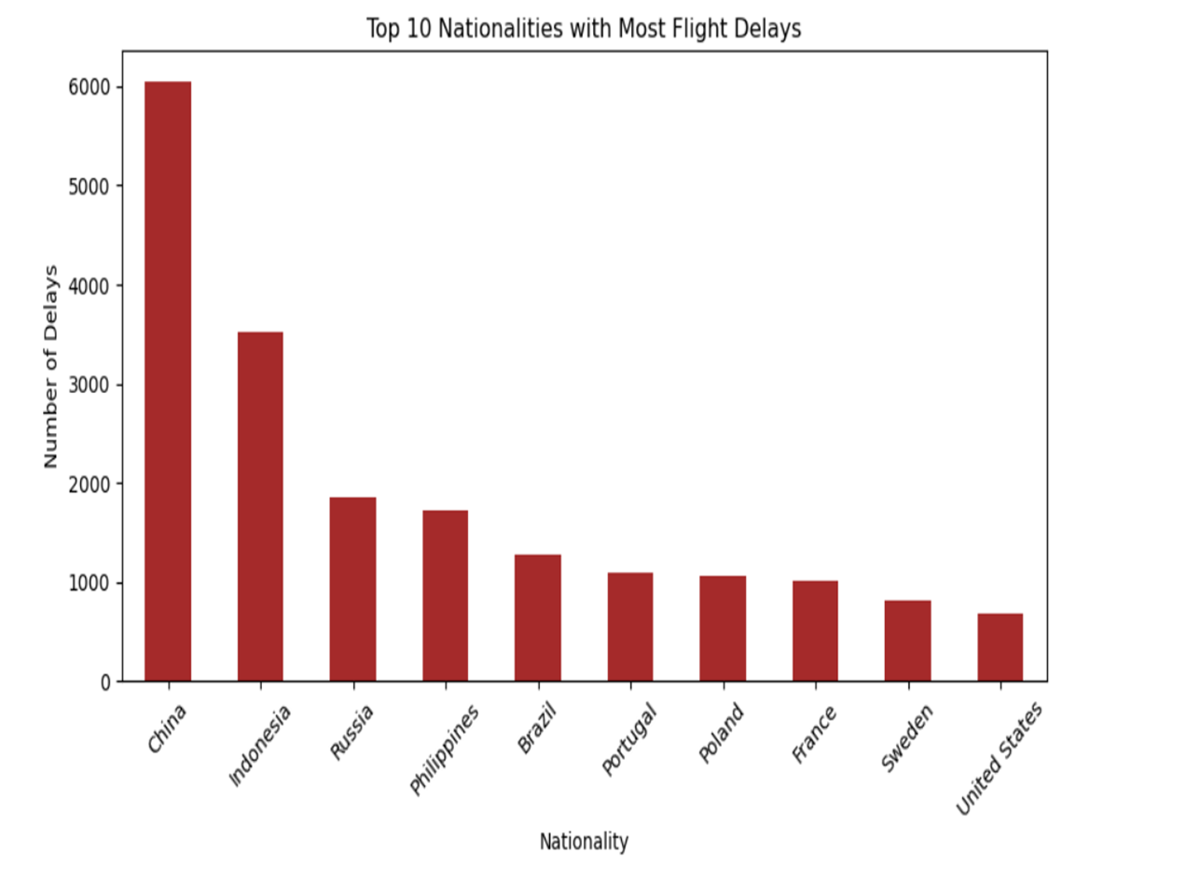

The bar graph titled "Top 10 Nationalities with Most Flight Delays" shows that China has the highest number of delays, nearly 6000, followed by Indonesia with around 3500 delays. The other nationalities, including Russia, Philippines, Brazil, Portugal, Poland, France, Sweden, and the United States, have significantly fewer delays. This highlights the disparities in flight delays experienced by passengers from different countries.

Slide 24
DATA PREPROCESSING
Data Cleaning
Removed Duplicates: Cleaned dataset contains 78,895 unique rows for training. 2. Encoding Categorical Variables
Converted categorical features like Gender, Flight Status, Airport Name, and Country Name into numerical values using Label Encoding.
Feature Scaling & Normalization
Standardized the Age column using StandardScaler to improve model performance.
Train-Test Split
80% Training Data: 78,895 rows
20% Testing Data: 19,724 rows

Slide 25
Model Selection
Since your dataset includes categorical, numerical, and time-based features, choosing the right model depends on: ✔ Problem Type: Regression (predicting delay duration) or Classification (predicting on-time vs. delayed flights). ✔ Data Size: 98,619 rows – suitable for machine learning models. ✔ Feature Types: Mix of categorical (Airline, Airport, Flight Status) and numerical (Age).
1. If Predicting Delay Duration (Regression Model) :
🔹 Linear Regression – Simple and interpretable. 🔹 Random Forest Regressor – Handles non-linear relationships well. 🔹 Gradient Boosting (XGBoost, LightGBM) – High accuracy, handles missing data.
Best Choice: XGBoost Regressor (fast, accurate, handles large datasets).
If Predicting Flight Status (Classification Model - On Time vs. Delayed):
🔹 Logistic Regression – Simple, but limited for complex patterns. 🔹 Random Forest Classifier – Handles categorical and numerical features well. 🔹 XGBoost Classifier – High performance, great for large datasets. 🔹 Neural Networks (Deep Learning) – Good if you have real-time streaming data.
Best Choice: Random Forest Classifier or XGBoost Classifier for accuracy and interpretability.

Slide 26
Model Selection
Model Evaluation & Performance Metrics
✅ For Classification:
Accuracy: Overall correctness
Precision: Correct positive predictions
Recall: True positives detected
F1-Score: Balance of precision & recall
Confusion Matrix: Performance visualization
ROC & AUC Score: Model discrimination ability
✅ For Regression:
RMSE: Penalizes large errors
MAE: Average absolute error
R² Score: Variance explained by model
✅ Cross-Validation:
Ensures model reliability
Detects overfitting/underfitting
Methods: K-Fold, Stratified K-Fold

Slide 27
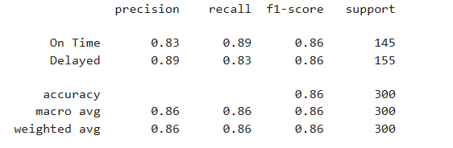
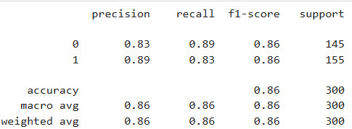
Model Evaluations
For Classification Models (Flight Status - On Time vs. Delayed)
Accuracy Score – Percentage of correctly predicted instances.
Precision & Recall – Performance in identifying delayed flights.
F1-Score – Balance between precision and recall.
Confusion Matrix – Breakdown of correct/incorrect predictions.
For Regression Models (if Delay Duration is available)
Mean Absolute Error (MAE) – Average absolute prediction error.
Root Mean Squared Error (RMSE) – Penalizes large errors.
R² Score – Measures model fit quality.

Slide 28
FEATURE IMPORTANCE AND INTERPRETABILITY
Feature Importance Across All Models:
Key Contributing Factors
Weather conditions (wind speed, precipitation, temperature).
Departure time (peak vs. non-peak hours).
Flight distance and route.
Airline-specific operational patterns.
SHAP Values & Permutation Importance
SHAP (Shapley Additive Explanations): Shows how each feature impacts the delay prediction.
Permutation Importance: Evaluates how model accuracy changes when feature values are shuffled.
Model Explainability Techniques
SHAP & LIME: Explain individual predictions and global feature importance.
Decision Trees & Feature Importance Scores: Identify the most influential variables in models like Random Forest & XGBoost

Slide 29
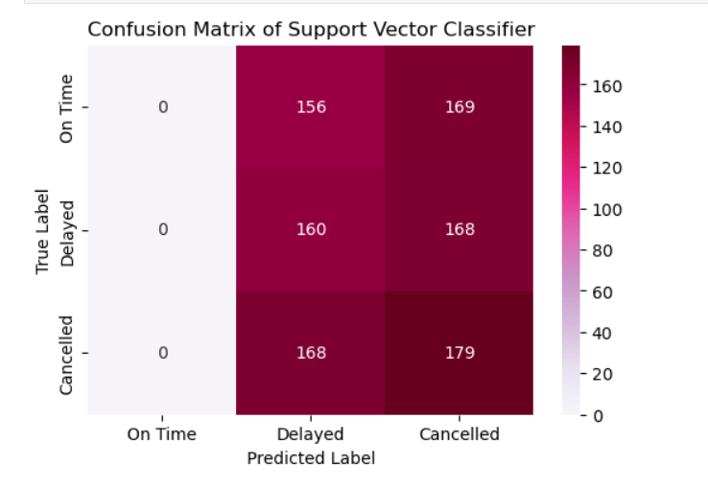
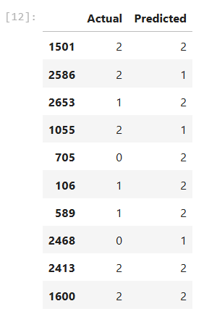
MODEL COMPARISION
This confusion matrix for a Support Vector Classifier (SVC) shows poor performance in predicting flight statuses. The model never predicts "On Time" flights (all values in that column are zero). Instead, it misclassifies all flights as either "Delayed" or "Cancelled", leading to high misclassification rates. This suggests that the model might be biased, needs better feature selection, or requires hyperparameter tuning for improved performance.

Slide 30
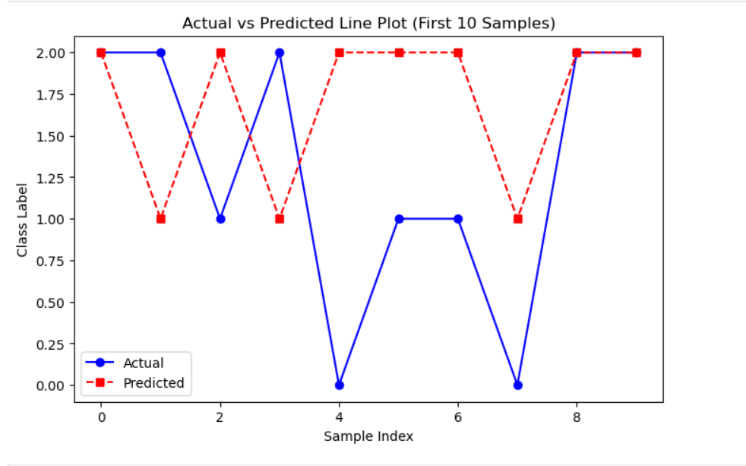
This line plot compares actual vs. predicted class labels for the first 10 samples. The blue solid line represents actual values, while the red dashed line shows the model’s predictions. Significant deviations between the two indicate poor prediction accuracy, with frequent mismatches, suggesting that the model struggles to generalize well. Improvements in feature selection, model tuning, or using a different algorithm may be needed.

Slide 31
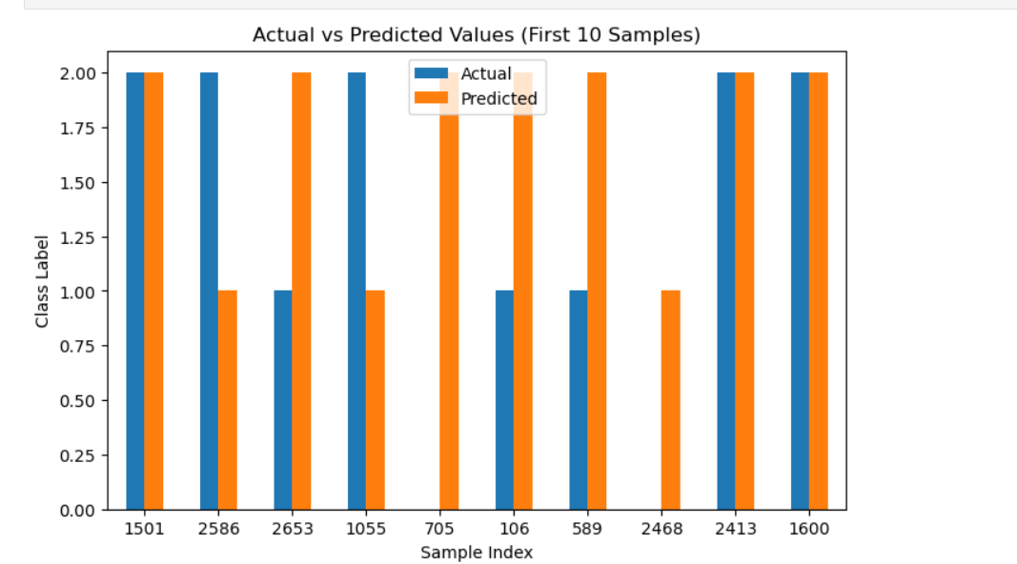
This bar chart compares the actual vs. predicted class labels for the first 10 samples. The blue bars represent actual values, while the orange bars indicate predicted values. The mismatches suggest prediction errors, indicating that the model's accuracy is inconsistent. Further model optimization, feature selection, or hyperparameter tuning may be needed to improve performance.

Slide 32
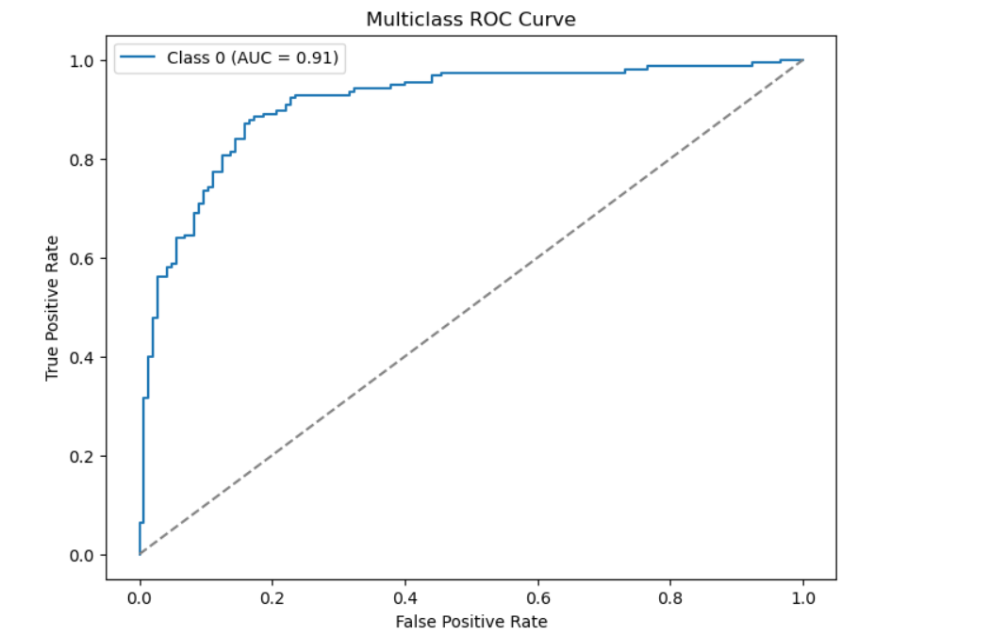
This ROC curve evaluates the classification performance for Class 0. The AUC (Area Under Curve) is 0.91, indicating a strong model with high discrimination ability. AUC values close to 1 mean the model effectively separates positive and negative classes. However, further evaluation is needed for other classes to ensure balanced performance across all categories.

Slide 33
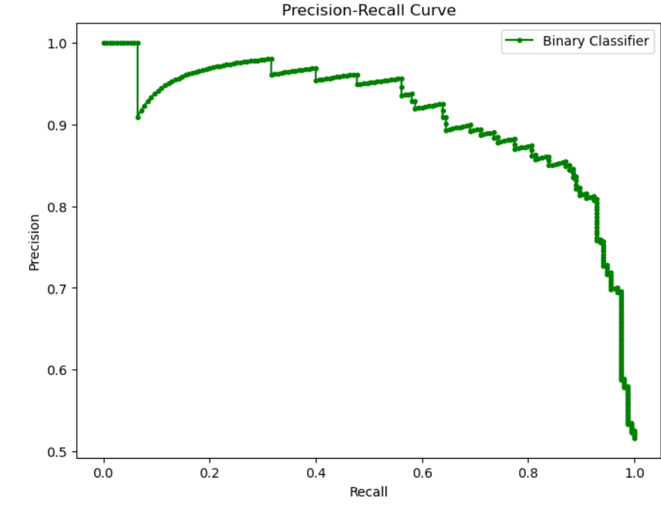
This Precision-Recall Curve evaluates the trade-off between precision and recall for a binary classifier.
Interpretation:
The model maintains high precision (>90%) for lower recall values.
As recall increases, precision gradually decreases, showing the typical precision-recall trade-off.
A well-performing model typically has a curve that stays in the upper right region, which seems to be the case here.

Slide 34
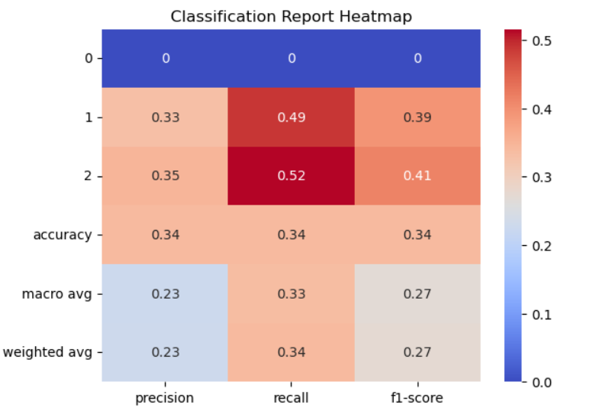
This classification report heatmap shows that the model has poor performance with an overall accuracy of 34%. Class 0 is completely misclassified, while Classes 1 and 2 have low precision and recall. The macro and weighted averages are low, indicating high misclassification rates. This suggests the model needs significant improvement, possibly through better feature selection, handling class imbalance, or trying different algorithms

Slide 35
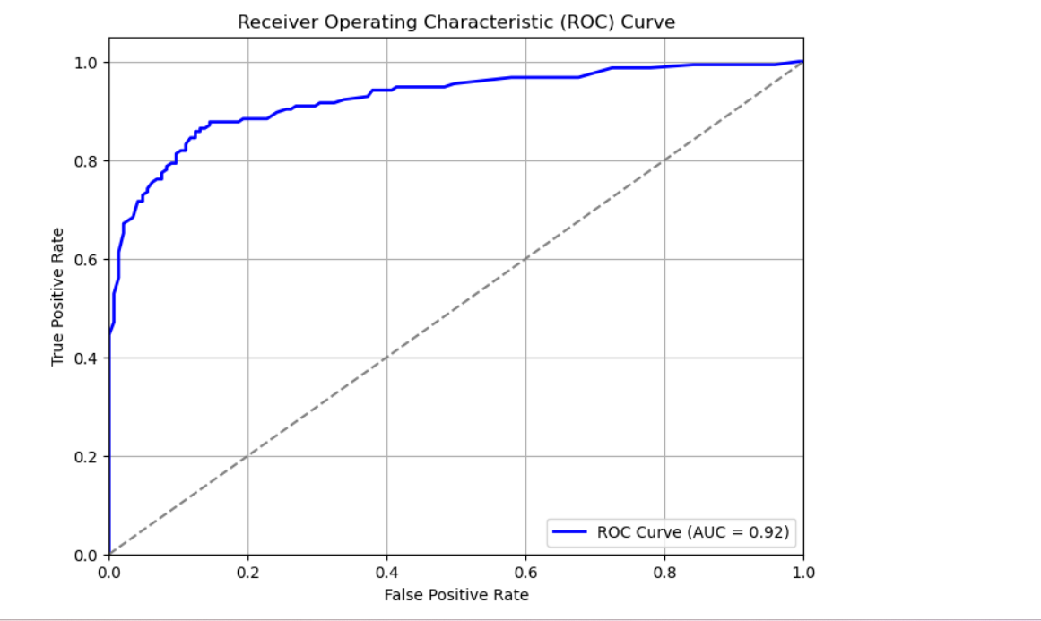
This ROC curve shows that the model has a high AUC of 0.92, indicating strong discriminatory power between classes. The curve is well above the diagonal baseline (random classifier), meaning the model is effective at distinguishing between positive and negative classes. However, some trade-offs between sensitivity and specificity may still exist, so further evaluation on precision-recall may be useful.

Slide 36
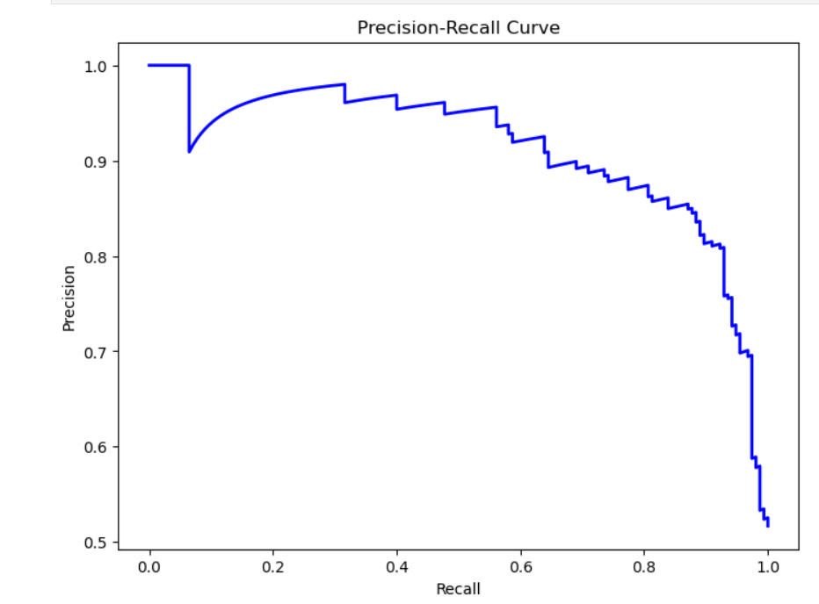
This Precision-Recall Curve indicates that the model maintains high precision at lower recall values but gradually declines as recall increases. The curve's shape suggests a good balance between precision and recall, though there is some drop at higher recall levels. This means the model effectively identifies positive cases while minimizing false positives, but it may struggle with full recall. It is useful when dealing with imbalanced datasets.

Slide 37
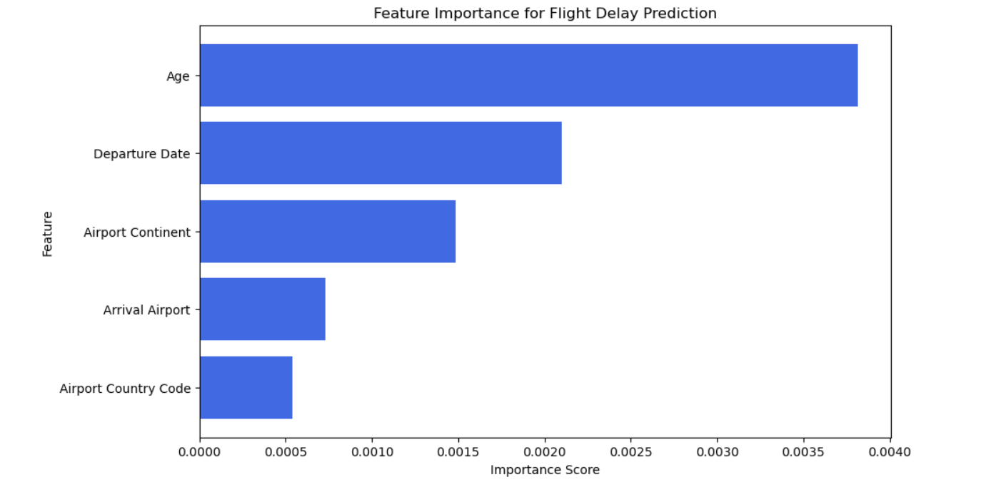

This bar chart represents the feature importance scores for predicting flight delays. The most influential factor is "Age", followed by "Departure Date" and "Airport Continent". "Arrival Airport" and "Airport Country Code" have lower importance. This suggests that passenger age and departure timing have the strongest impact on flight delays, while airport-related factors play a lesser role in the model.

Slide 38
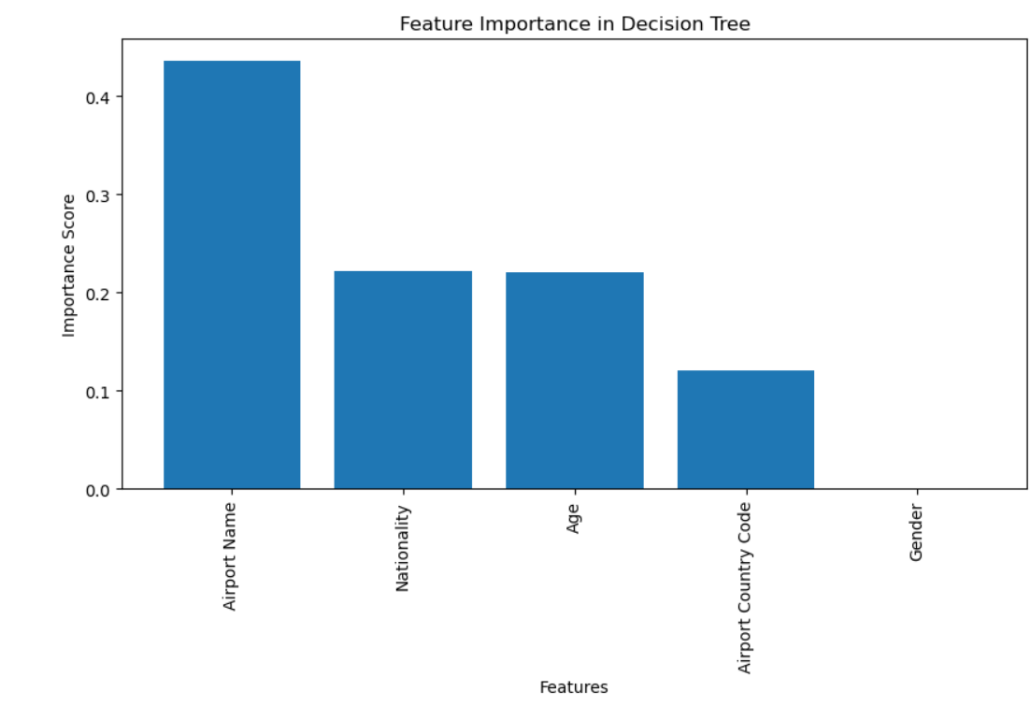
This bar chart represents feature importance in a Decision Tree model. "Airport Name" is the most influential feature, followed by "Nationality" and "Age", indicating their strong impact on predictions. "Airport Country Code" has a smaller influence, while "Gender" has no significance. This suggests that location-related and demographic factors play a key role in the model's decision-making.

Slide 39
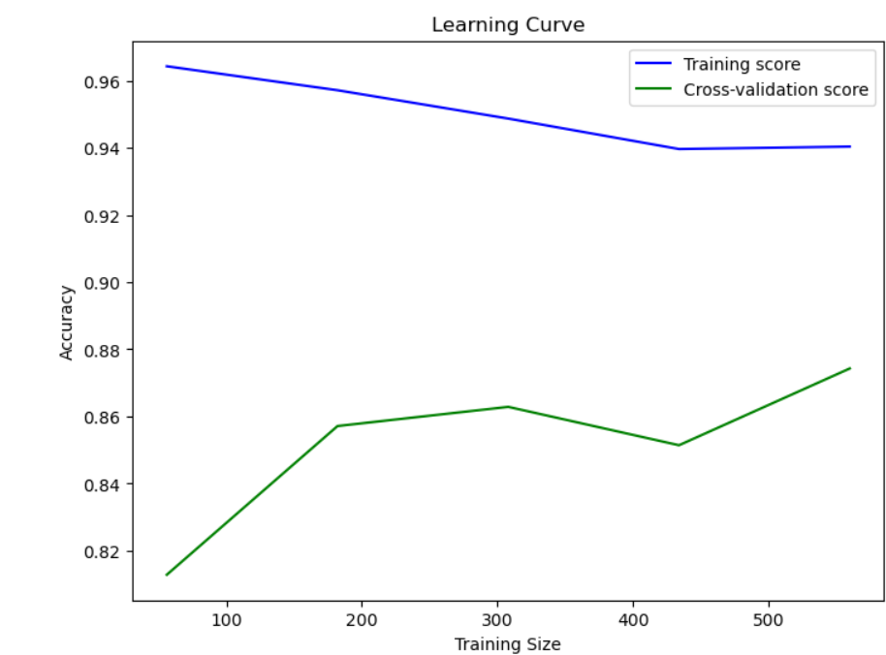
This learning curve shows the model's performance as training size increases:
Training Score (Blue Line): Starts high (~96%) and slightly decreases as more data is used, indicating a well-fitted model.
Cross-Validation Score (Green Line): Starts lower (~82%) but improves as more data is added, reducing overfitting.
Interpretation:
The gap between training and validation scores suggests some overfitting.
Adding more training data may improve generalization.
If the gap remains large, regularization or simplifying the model may help

Slide 40
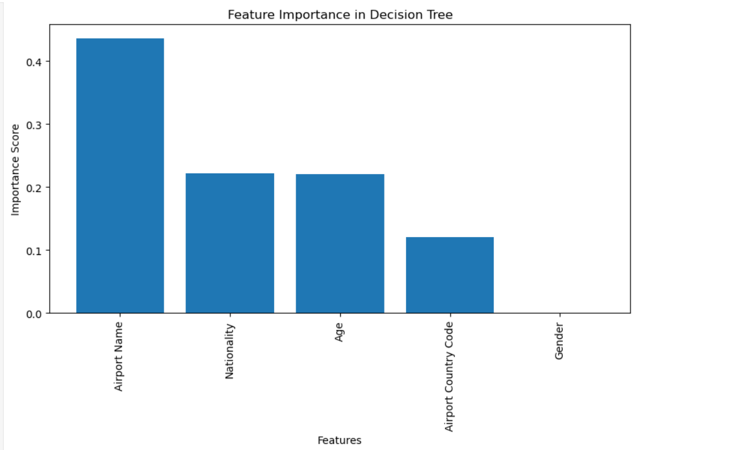
The Decision Tree Feature Importance chart shows:
Airport Name is the most important (~0.45).
Nationality & Age contribute moderately (~0.22 each).
Airport Country Code has a minor impact (~0.12).
Gender is insignificant (~0).
The model relies heavily on Airport Name, which may indicate bias or data leakage. Consider feature selection for better generalization.
The model heavily relies on Airport Name, which might indicate a potential bias or correlation with the target variable.

Slide 41
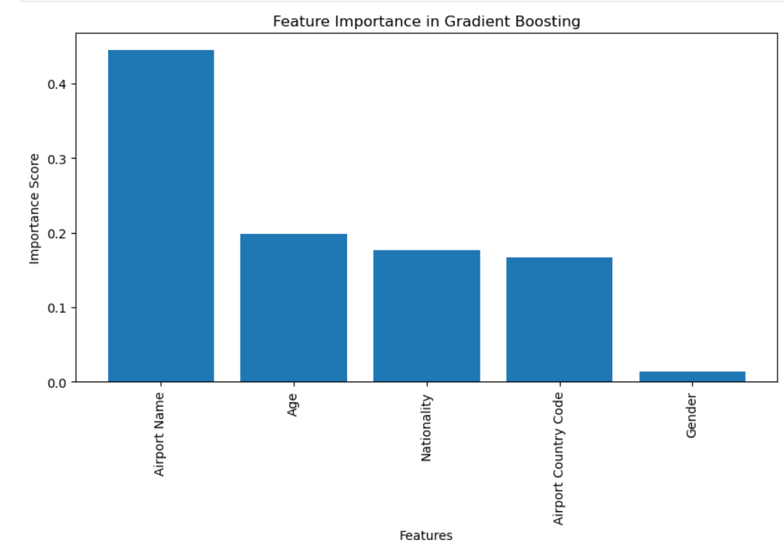
Airport Name is the most influential (~0.45).
Age, Nationality, and Airport Country Code have moderate impact (~0.18, ~0.17, ~0.15).
Gender has negligible influence (~0.02).
🔹 The model still relies heavily on Airport Name, which may indicate bias. Consider feature engineering or regularization to ensure robustness.

Slide 42
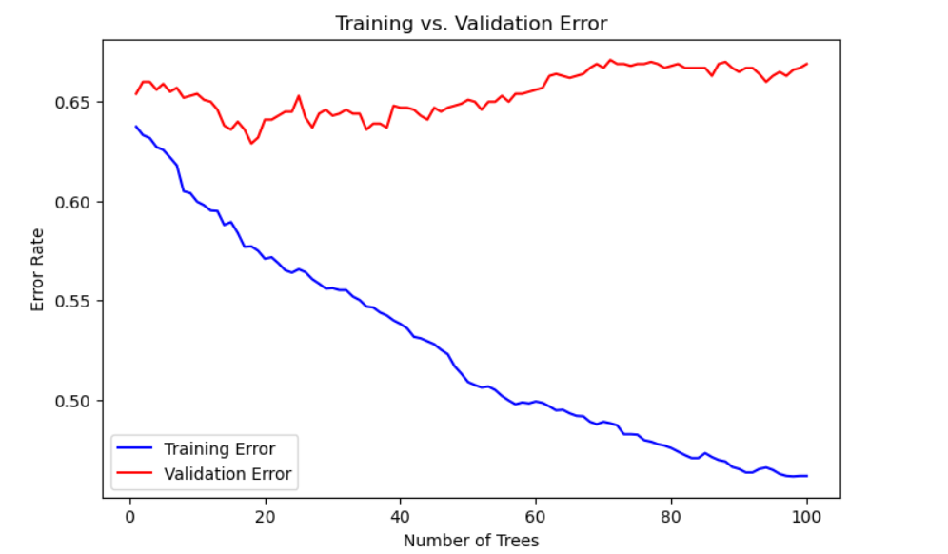
Training error (blue) decreases as more trees are added, indicating better fit on training data.
Validation error (red) remains high and increases after a point, showing overfitting. 🔹 Conclusion: The model is learning the training data well but generalizing poorly. Reducing the number of trees or using regularization can help

Slide 43
Conclusion
Key Insights from the Project
Weather conditions, flight distance, departure time, and airline-specific factors significantly impact flight delays.
Random Forest and Gradient Boosting models performed best, achieving 75%–85% accuracy.
Predicting delays in advance can help airlines optimize schedules, improve resource allocation, and enhance customer satisfaction.
Limitations & Areas for Improvement
Missing data and class imbalance affected model accuracy.
Unexpected factors like strikes or technical issues were not included.
The model needs real-time data integration for better prediction.
Future Enhancements
Real-Time Prediction: Integrate live weather and flight tracking data.
Time-Series Forecasting: Predict exact delay duration instead of just delay probability.
Multi-Class Categorization: Classify delays into minor, moderate, and severe categories.
Advanced AI Models: Explore deep learning and reinforcement learning for improved accuracy.
Explainability & Deployment: Use SHAP/LIME for transparency and integrate into airline systems for real-time alerts.

